Slide 1
IEnumerable, IQueryable ICollection, IList IDictionary. Indexer, Yield, iteration

Slide 2
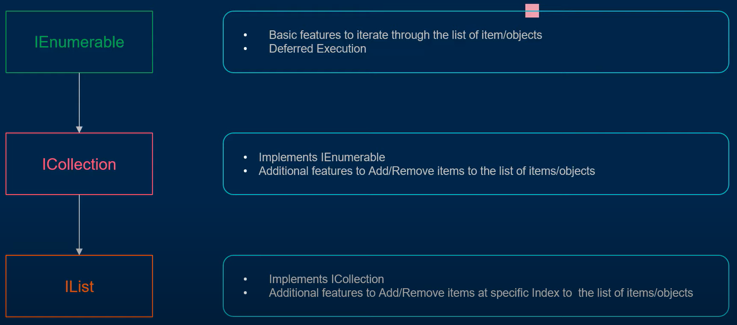

Slide 3

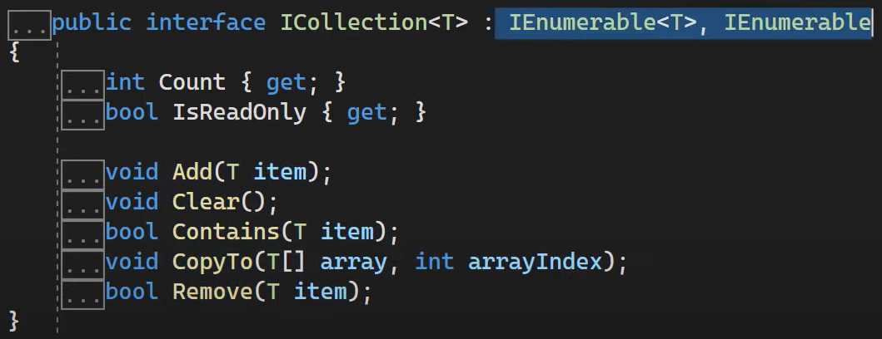


Slide 4
